Slide 1
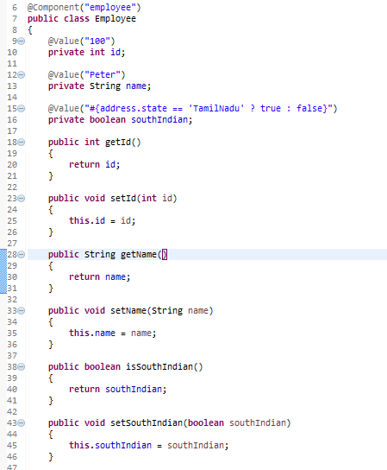
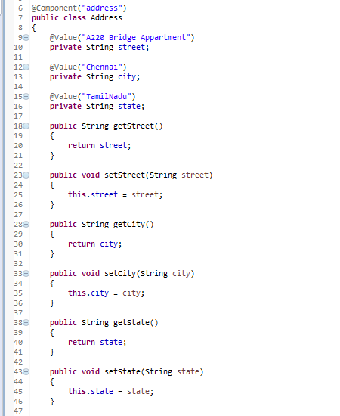
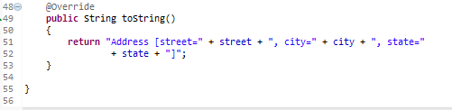
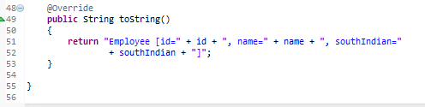
Spring EL ternary operator (if-then-else) example - Annotation
Spring EL supports ternary operator , perform “if then else” conditional checking. For example,
condition ? true : false

Slide 2
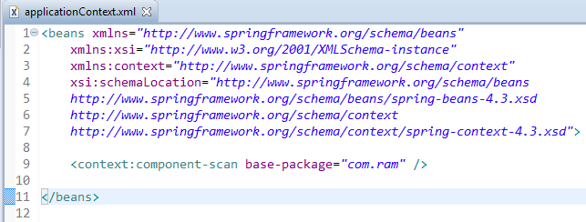
Spring EL method invocation - Annotation
Enable auto component scanning.

Slide 3
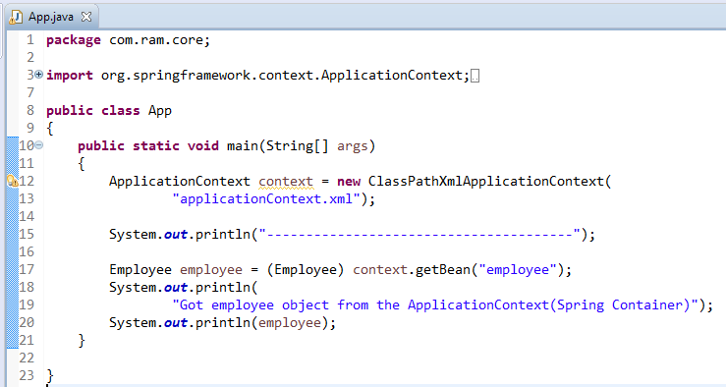
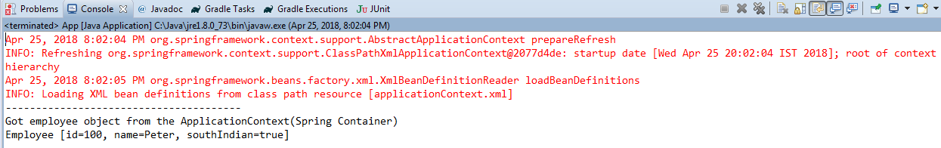
Spring EL method invocation - Annotation

